Slide 1
Sejong Medix
Company Profile
Sejong Medix Co.
2022 ver.

Slide 2
Sejong medix
Has more than two decades of experience in the pharmaceutical and in health care industries.
Has sub-distributors, wholesalers, and retailers in total 250
Since 1999
How long
In Korea
Distributor
With clients
Was established in 1999 with a mission to distribute high quality medical supplies and pharmaceutical products
Has nationwide networks to sell and cover all provinces in Korea and 60 sales representatives
Has a very close relationship with doctors, professors, and pharmacists
in the general hospitals, the medical clinics, and pharmacies.
2

Slide 3
Annual Sales
3

Slide 4
Target Market Healthcare field
Medical and Medicine supplies mainly injection products
Chelation and Vitamine
Health care food
Healthcare field
Medical Device
Cosmetic
Quasi-drugs
4

Slide 5
About our clients
Hospitals
The information of number of hospital in KOREA on healthcare big data HUB,2017
30-50%
5-30%
30-50%
-
General hospital
Mid-size hospital
Private clinic
Pharmacy
Number of in Korea | 301 |  | 1450 |  | 6500 (only for Derm,PS,OBGY,OS) |  | -
Number of SJ directly sales | 100-150 |  | 30-50 |  | 2000-3000 |  | 200-300
5

Slide 6
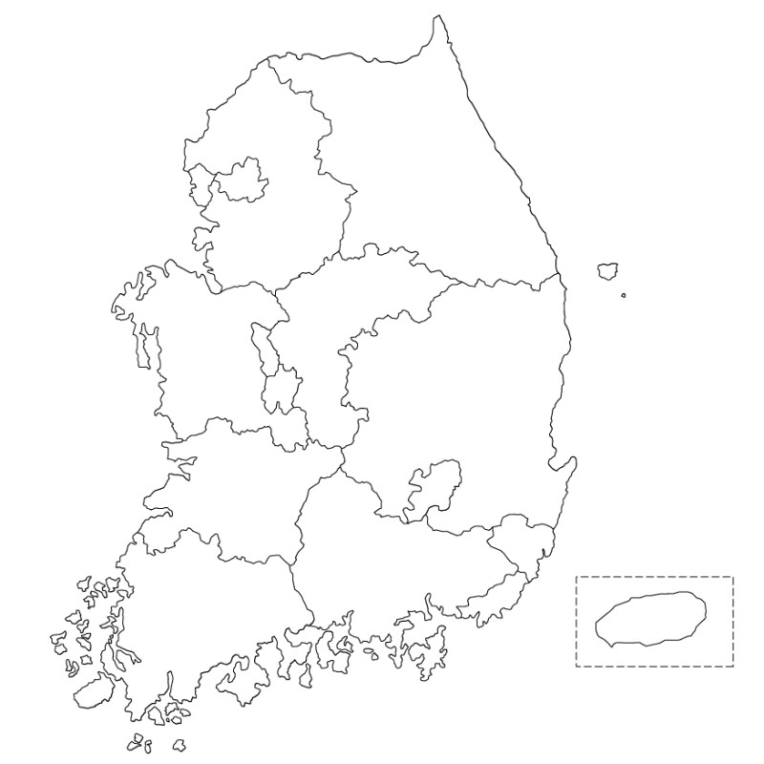
How we do sale national wide
Have very close ties to cover all Korean markets
with sub-distributors, wholesalers, retailers who are located in cities, districts, and towns where we are unable to approach. They are approximately 250.
17 administrative areas and is divided into 75 cities, 82 districts, and 69 towns in S.KOREA
Scattered our sales representatives at 12 branches where are located in administrative provinces.
Consistently visit hospitals and meet doctors
6

Slide 7
How we do sale national wide
Have a seminar or meeting
12 branches members have a seminar or meeting once a month and share the information of the competitors’ products.
Nationwide Network
They are also educated about our products, a recent market trendy, and new goods.
Strong and well organized nationwide network system
quickly penetrate the Korean markets and distribute our products quickly.
7

Slide 8
How do we sale
On-line Sale
Our company’s own on-line –sale
세종메딕스 (sejongmedix.co.kr)
Two type of malls
- For doctors
- For the end of clients
Medical devices, cosmetics and health supplements
8

Slide 9
How do we sale
Marketing strategy ; Attending exhibitions
We participate in many medical congresses, symposiums, and exhibitions and set up our own booth there to meet and introduce our products to doctors and professors.
24 booths are established a year to promote our products. It is the best way to raise our products' brand awareness to doctors.
There are opportunities for us to seek and find key opinion leaders (KOL) and we imprint our products to them. Key opinion leaders we know introduce their co-workers or bring concerned persons who are planning to establish the private clinics to us.
During the period of these events, we try to prospect new opinion leaders and make an effort to have a new connection with new doctors.
For a firm cooperative relationship with medical associations in various sectors, we also support them in many different ways.
9

Slide 10
How do we sale
Marketing strategy ; Advertising in a scientific journal etc.
We advertise in a scientific journal, magazine, and newspaper related to the medical device or pharmaceutical industries.
We also join the Power bloggers to advertise our products.
We make our own brochures and banners about the products as one of the marketing tools and deliver them to our customers. Brochures and banners are manufactured after obtaining approval from legal manufacturers in advance.
10

Slide 11
Our company ‘s
Sejong medix
Address:
134, Dongnam-ro, Songpa-gu, Seoul, Korea
(Munjeong dong, Myungno Building 6th FL)
Tel. : +82.(02).404.2920
Fax. : +82.(02).404.2991
Web site : (sejongmedix.co.kr)
11

Slide 12
Thank you

